Slide 1
Video Conferencing App
Final Pitch Deck – Team Presentation

Slide 2
Problem Statement
- Existing tools are heavy, require installations or sign-ins.
- Privacy concerns with third-party apps.
- Freelancers, educators, and remote teams face friction in using such tools.
- Need for a secure, browser-native, no-login video conferencing solution.

Slide 3
Our Solution
A full-stack peer-to-peer video conferencing platform with:
- One-click room creation and joining
- Screen sharing and chat during calls
- No downloads, no sign-up
- Built with WebRTC, PeerJS, Socket.IO, and Node.js

Slide 4
Key Features
- Real-time video/audio via WebRTC
- PeerJS-based connections
- Chat messaging with Socket.IO
- Screen sharing with media capture
- Session recording and download
- Works directly in the browser

Slide 5
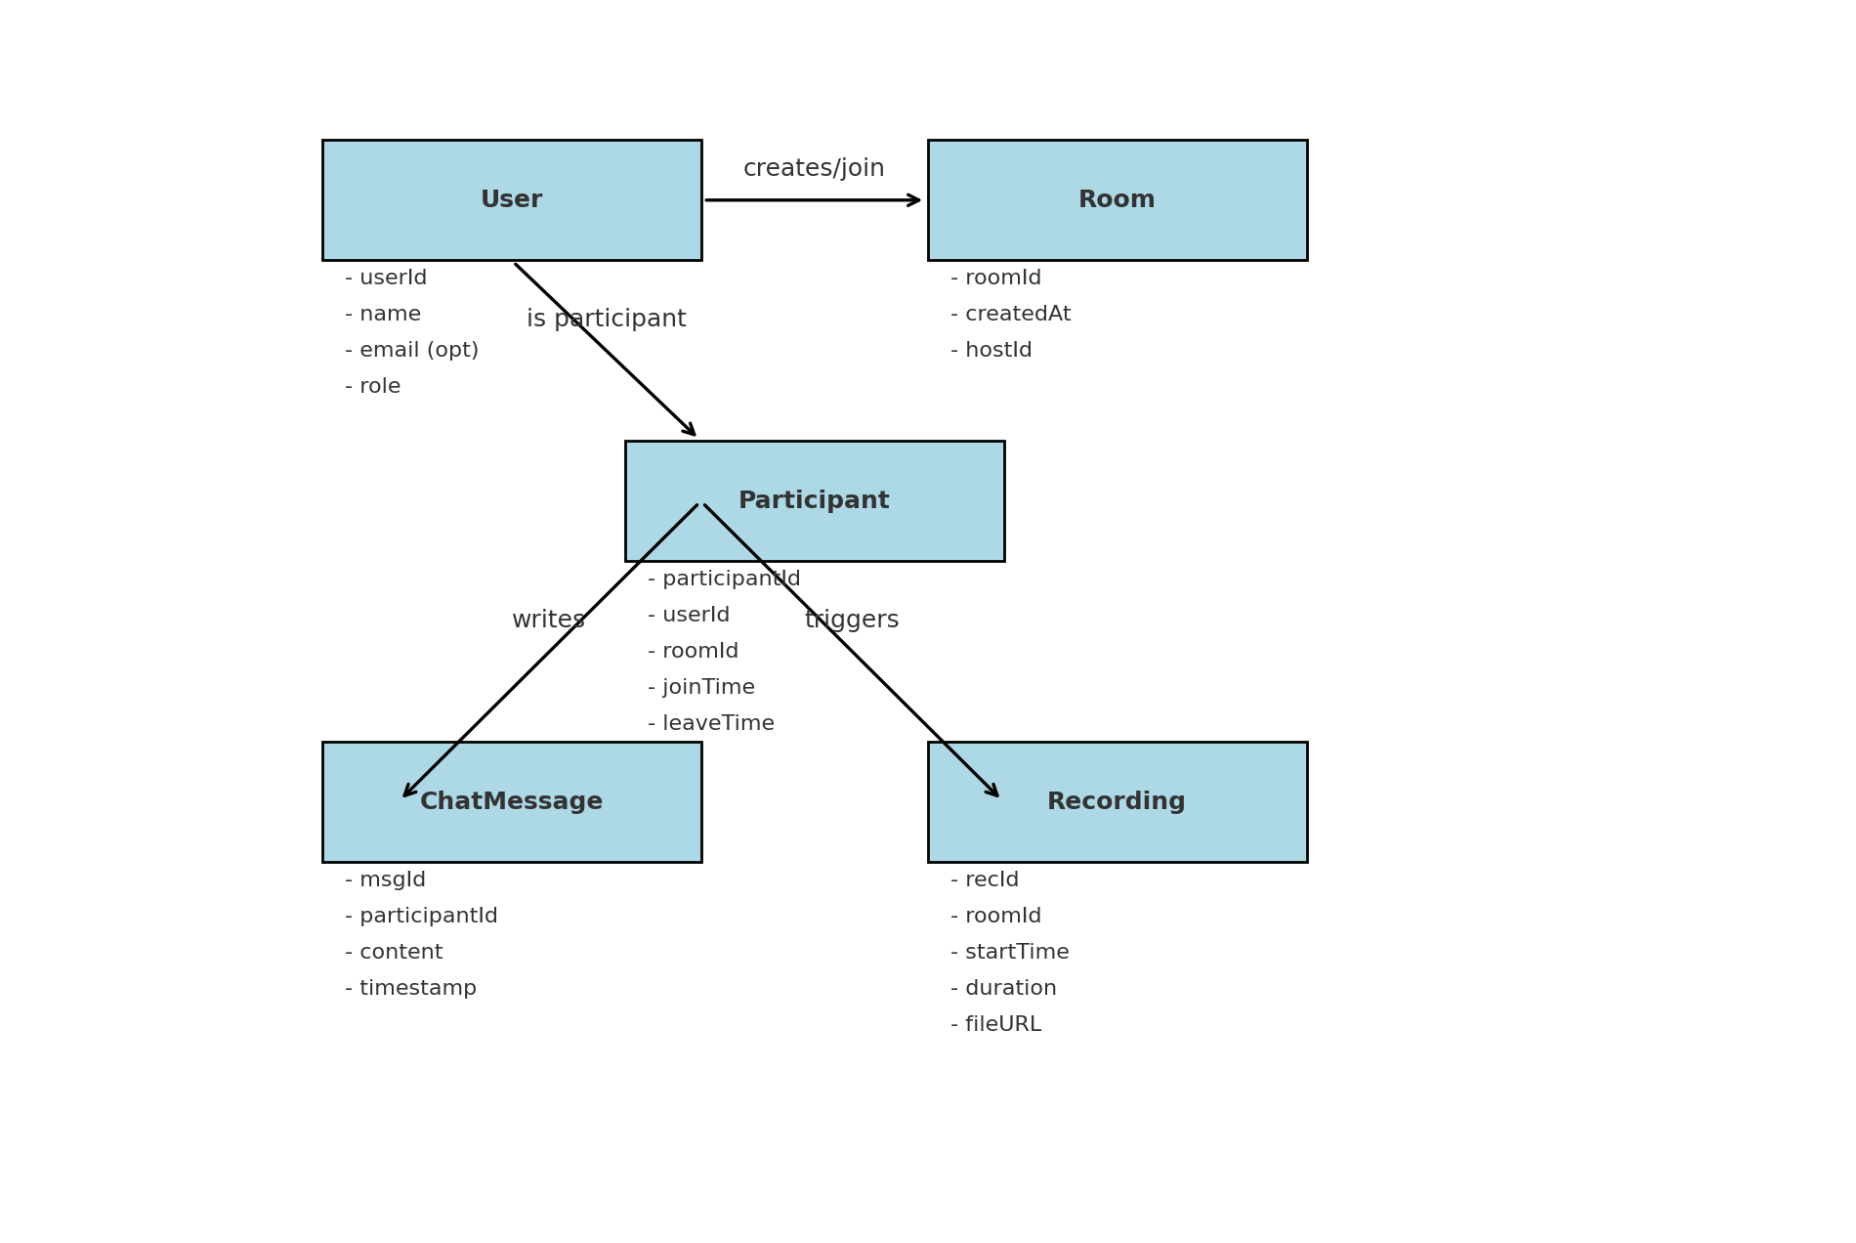
System Architecture

Slide 6
Technology Stack
- Frontend: HTML, CSS, JavaScript (Vanilla/React)
- Backend: Node.js with Express
- Real-time: WebRTC, PeerJS, Socket.IO
- Hosting: Local / Cloud Server (PM2/Nginx)
- Optional DB: MongoDB

Slide 7
Future Scope
- Add authentication and user profiles
- Save chat history and call logs
- Group call moderation & hand raising
- Mobile app (React Native / PWA)
- Integration with calendars and schedulers

Slide 8
Thank You!
Q&A – Team Video Conferencing App

